Slide 2
Regulations, Standards and Frameworks - Definition
Compliance and regulatory frameworks are sets of guidelines and best practices. Organizations follow these guidelines to meet regulatory requirements, improve processes, strengthen security, and achieve other business objectives.
These frameworks give us a common language that can be used to build the culture of security.
Notes:
Stored Procedures

Slide 3
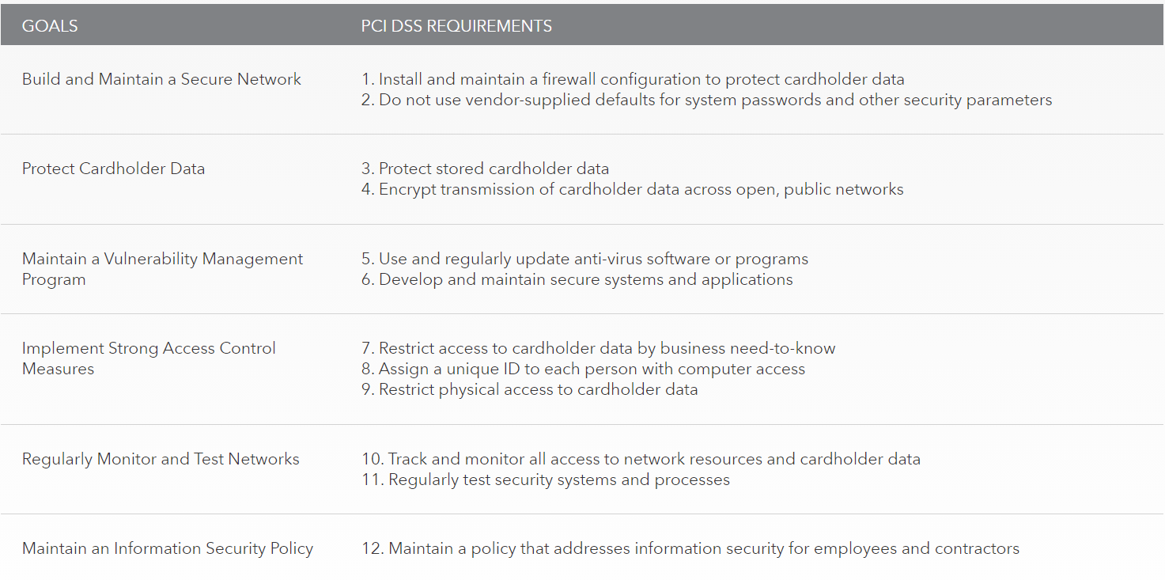
Payment Card Industry Data Security Standard - (PCI DSS)

Slide 4
Key Frameworks - Center for Internet Security (CIS)
The 20 CIS Controls: https://www.cisecurity.org/controls/cis-controls-list/
Basic CIS Controls ( 1 - 6 )
Foundational CIS Controls ( 7 – 16 )
Organizational CIS Controls ( 17 – 20 )
CIS Controls Version 7.1 Implementation Groups 1.2.xlsx
CIS-Controls-Version-7-1.pdf
Notes:
Stored Procedures

Slide 5
Key Frameworks - NIST CSF - Overview
The Framework provides a common taxonomy and mechanism for organizations to:
1) Describe their current cybersecurity posture;
2) Describe their target state for cybersecurity;
3) Identify and prioritize opportunities for improvement within the context of a
continuous and repeatable process;
4) Assess progress toward the target state;
5) Communicate among internal and external stakeholders about cybersecurity risk.
NOTE: The Framework is not a one-size-fits-all approach to managing cybersecurity risk for critical infrastructure.
NIST CSF V1-1.pdf

Slide 6
Key Frameworks - NIST CSF - Three Primary Components
Core
Desired cybersecurity outcomes organized in a hierarchy and aligned to more detailed guidance and controls
Profiles
Alignment of an organization’s requirements and objectives, risk appetite and resources using the desired outcomes of the Framework Core
Implementation Tiers
A qualitative measure of organizational cybersecurity risk management practices
Notes:
Stored Procedures

Slide 7
Key Frameworks - NIST RMF - Overview
The RMF emphasizes risk management by promoting the development of security and privacy capabilities into information systems throughout the system development life cycle (SDLC);
The management of organizational risk is a key element in the organization's information security program and provides an effective framework for selecting the appropriate security controls for a system.
Notes:
Stored Procedures

Slide 8
Key Frameworks - NIST RMF - 7 Steps
0. Prepare carries out essential activities at the organization, mission and business process, and information system levels of the enterprise to help prepare the organization to manage its security and privacy risks using the RMF.
1. Categorize the system and the information processed, stored, and transmitted by that system based on an impact analysis.
2. Select an initial set of baseline security controls for the system based on the security categorization; tailoring and supplementing the security control baseline as needed based on organization assessment of risk and local conditions.
Notes:
Stored Procedures

Slide 9
Key Frameworks - NIST RMF - 7 Steps
3. Implement the security controls and document how the controls are deployed within the system and environment of operation.
4. Assess the security controls using appropriate procedures to determine the extent to which the controls are implemented correctly, operating as intended, and producing the desired outcome with respect to meeting the security requirements for the system.
Notes:
Stored Procedures

Slide 10
Key Frameworks - NIST RMF - 7 Steps
5. Authorize system operation based upon a determination of the risk to organizational operations and assets, individuals, other organizations and the Nation resulting from the operation of the system and the decision that this risk is acceptable.
6. Monitor and assess selected security controls in the system on an ongoing basis including assessing security control effectiveness, documenting changes to the system or environment of operation, conducting security impact analyses of the associated changes, and reporting the security state of the system to appropriate organizational officials.
Notes:
Stored Procedures

Slide 11
Key Frameworks - International Organization for Standardization (ISO) 27001/27002/27701/31000
ISO/IEC 27001:2013 - Information technology — Security techniques — Information security management systems — Requirements
ISO/IEC 27002:2013 - Information technology — Security techniques — Code of practice for information security controls
ISO/IEC 27701:2019 - Security techniques — Extension to ISO/IEC 27001 and ISO/IEC 27002 for privacy information management — Requirements and guidelines
ISO 31000:2018 Risk management — Guidelines
Notes:
Stored Procedures

Slide 12
Key Frameworks - SSAE SOC 2 Type I/II
Type I - provides a description of the controls provided by the audited organization and the auditor opinion based on the description, BUT... does not involve actual testing of controls.
A Type I Report is specifically defined by the SSAE 16 guidance as a “report on a description of a service organization’s system and the suitability of the design of controls”.
When performing a Type I report, the auditors will test the design effectiveness of your company’s defined controls by examining a sample of 1 item per control.
Type II - covers a minimum period of 6 months and requires testing of the controls and an opinion from the auditor as to effectiveness based upon test.
Notes:
Stored Procedures

Slide 13
Key Frameworks - SSAE SOC 2 Type I/II
The Service and Organization Controls (SOC) 2 Report will be performed in accordance with AT-C 205 and based upon the Trust Services Criteria, with the ability to test and report on the design (Type I) and operating (Type II) effectiveness of a service organization’s controls (just like SOC 1 / SSAE 18).
The SOC 2 report focuses on a business’s non-financial reporting controls as they relate to security, availability, processing integrity, confidentiality, and privacy of a system, as opposed to SOC 1/SSAE 18 which is focused on the financial reporting controls.
Notes:
Stored Procedures

Slide 14
Key Frameworks –Cloud Security Alliance Cloud Controls Matrix (CSA CCM)
The Cloud Controls Matrix (CCM) is a cybersecurity control framework for cloud computing aligned to the CSA best practices.
It is composed of 197 control objectives that are structured in 17 domains covering all key aspects of cloud technology.
It can be used as a tool for the systematic assessment of a cloud implementation, and provides guidance on which security controls should be implemented by which actor within the cloud supply chain.
Notes:
Stored Procedures

Slide 15
Benchmarks / secure configuration guides
Platform/vendor-specific guides
Web server
O/S
Application server
Network infrastructure devices
Notes:
Stored Procedures

